Slide 1


Slide 2

Innovation Norway:
Digital transformation from an IT perspective
A year after moving all our infrastructure to Azure
Maria Hermansen
Head of IT Infrastructure and Platform Services
Division People & Technology

Slide 3

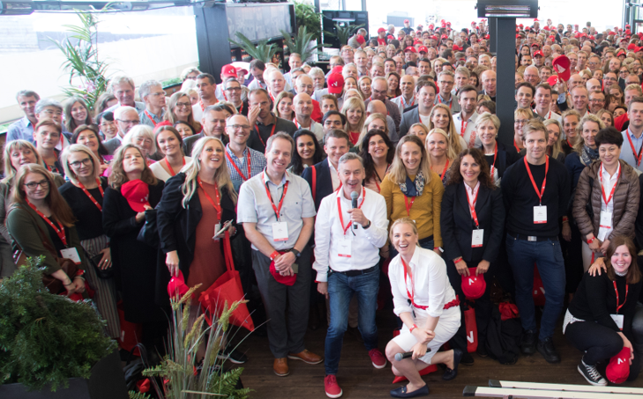
Innovation Norway
We give local ideas
global opportunities
Photo: Tom Hansen

Slide 4

Purpose
Main objectives
Innovation Norway is the policy instrument of national and county government authorities for developing value-creating business throughout Norway.
Innovation Norway aims to stimulate business innovation, being the sparring partner helping norwegian businesses to grow and commercialize on a global basis. Focus on sustainability.
Photo: Moelven

Slide 5
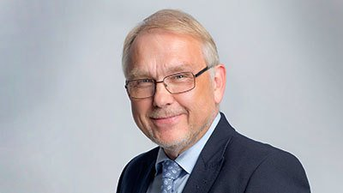
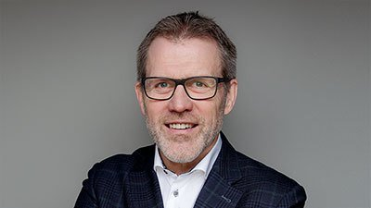

Our new Management Group
Håkon Haugli CEO
Vigdis Harsvik Acting division director: «Samfunn- og næringsutvikling»
Elisabeth Meyer Acting division director: Special assignments
Per Niederbach Division director: Growth and Export
Hans Martin Vikdal
Division director: Performance Management, accounting and finance
Hans Martin Vikdal Acting Deputy CEO
Leon Bakkebø Division director: Finance
Anette Matre Acting division director: People and Technology

Slide 6



Our sub-goals
More good
entrepreneurs
More companies with growth potential
More innovative business clusters
Photo: Moelven

Slide 7

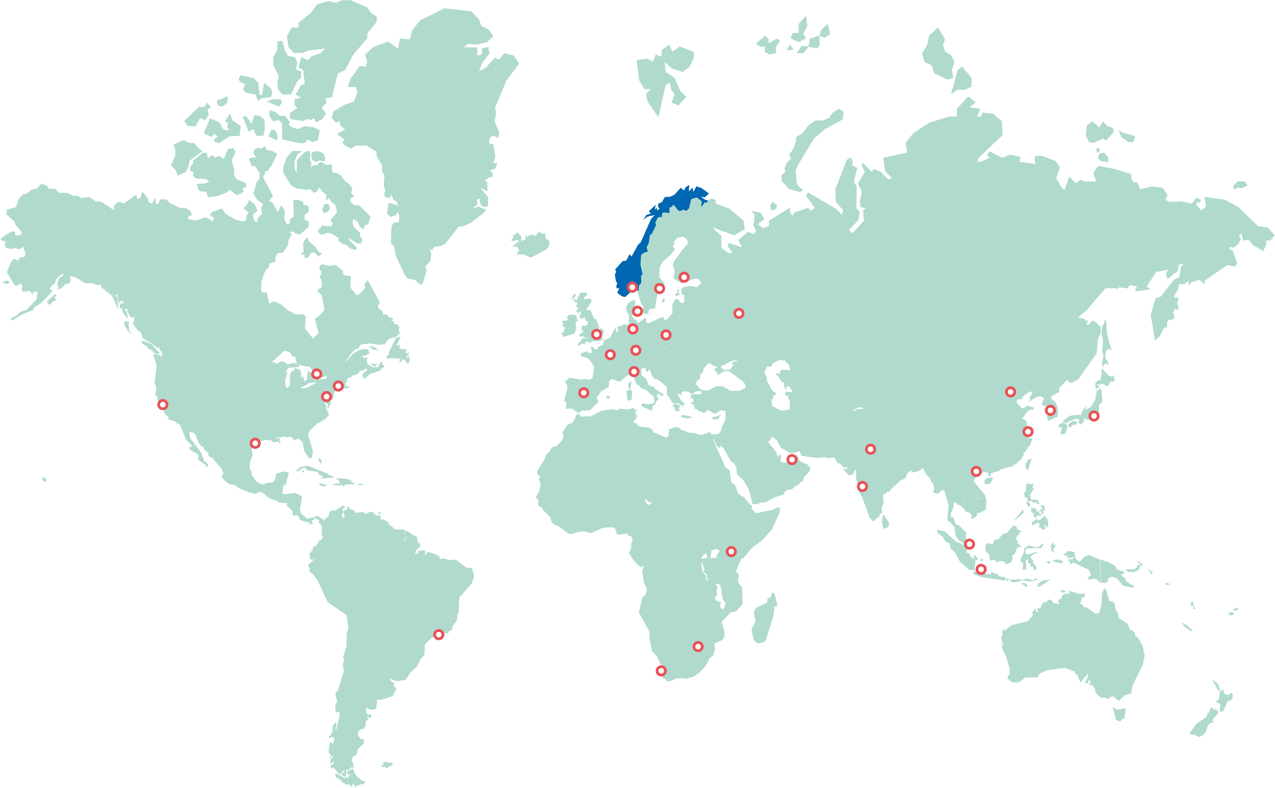
Regional offices in all norwegian counties, international – with 750 employees

Slide 8
On a yearly basis, we case handle
8 000 - 10 000
applications from start ups and established businesses from all over Norway.

Slide 9


















The global goals of the United Nations
- What does Norway has to offer?

Slide 10

Bioeconomy
Clean energy
Health and welfare
Ocean
Smart society
Creative industries and tourism

Slide 11



How do we contribute?
We are sparring partners who offer
Expertise
Networks
Capital
Photo: Moelven

Slide 12
One year after moving all our infrastructure to Azure
Background and the road ahead

Slide 13
Strategy period 2015-2019
IT driven:
Regulatory: Framework agreement for IT operations and support expired january 2019
Migration to Azure public cloud, reduction of technical debt
Innovation Norway first governmental organization of our size and complexity that went 100 % public cloud
Business driven:
INchange: Single case handling processes digitized, and modules developed for scaling
2019: 30 % of funding cases digitized

Slide 14
Strategy period 2020-2025
Business driven, with IT as advisor and partner:
Digital change of pace: Holistic view of processes for digital business development at company level
Organizational change to reduce overlap between responsibility and tasks
Context: Evaluation of the policy instruments and region reform
Turning recources toward customer needs and orientation
Main product value streams: DigiKunde, DigiBank og DigiOrg
Stable and secure IT infrastructure and platform services

Slide 15
Measuring parametres for success

Slide 16

High level measurement og success
Cross functional teams, supported by board and management group, holistic prioritizing
Faster deliveries and value to customer, transformative improvement and benefit realization
Relevant digital competence and capacity across the organization
Improved and simplified customer experience
More value from IT investments, including stable and secure platform services
Cross functional teams and agile desicion making
Digital customer handling and data driven insight
Modern cloud based infrastructure and platform services

Slide 17
How does the transformation affect the organization?

Slide 18
High level activities and milestones
2019-2020
Business as usual
Cross functional product teams
DIGIcustomer
DIGIbank
DIGIorg
Roadmap for prioritized deliveries (value streams within product teams) Predictability and clear direction towards agile deliveries and milestones
Flexibility in order to adjust to changes and impact from evaluation of the policy instruments and region reform

Slide 19
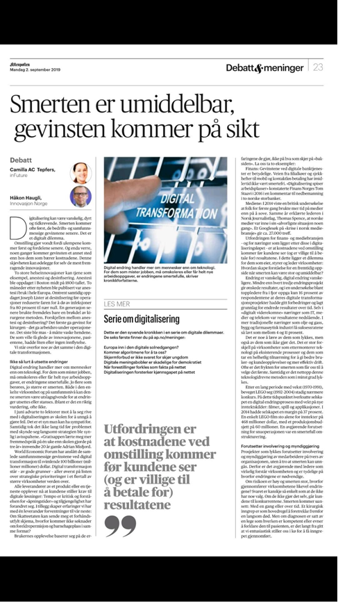
Organizational development:
digital change of pace
Our board and owners have ordered a digital change of pace, involving a substantial strengthening of digital resources by 2025
Change of competence among internal staff, with focus on transformative education, recruitment of digital business developers
Prioritizing different skills when recruiting
2025 as the planning with corresponding shift in KPIs

Slide 20
How does IT Infrastructure and Platform Services support
Innovations Norway´s mandate?

Slide 21
Competence and cross functional cooperation
Digital
Business development
Continous integration and deployment
Benefits realization
Benefits realization
Benefits realization
DIGIcustomer
DIGIbank
DIGIorg
Change mgmt
Change mgmt
Change mgmt
Functional prioritizing
Functional prioritazing
Functional prioritazing
Design
Design thinking
Claims collection
Process modeling
Design thinking
Claims collection
Process modeling
Design thinking
Claims collection
UX/UI
Process modeling
UX/UI
UX/UI
develop
Delivery management
Business development
Delivery management
Business development
Delivery management
Business development
Development
Integration
Development
Integration
Development
Integration
QA & Test
QA & Test
QA & Test
CoE O365
CoE Analyse
IT business
application
Vendor management, architecture and information security
ICT
Technology platform
IT Operations
IT Solution Architecture
IT Development
IT Continous Improvement
Core Solutions
Test
Integrations
IT security
Support
FinOps
IT Workplace
IT Platform

Slide 22
Cross functional teams & roles
Product sponsor from Management Group
Working agile on cross functional teams
Focus on value streams
Backlog
Correlating functional and non-functional requirements
Product Owner
(PO)
Team Coordinator
(TC)
Business Developers
Developers
IT Platform Engineers

Slide 23
Infrastructure and Platform Services
Organization and teams
Insourcing and recruiting core competence, implementing IT governance, operate our own public cloud environment in Azure, both Iaas and Paas. Risk management.
CoE O365
IT business
application
CoE Analyse
Vendor management, architecture and information security
ICT
Technology platform
IT Operations
IT Solution Architecture
IT Development
IT Continous Improvement
Core Solutions
Test
Integrations
IT security
Support
FinOps
IT Workplace
IT Platform
Correlations and dependencies

Slide 24
Infrastructure and Platform Services as an enabler
More than run
Establishing pipeline for continous integration and deployment (SecDevOps)
Working in the same cadence as the other product teams
Contious improvment and investment in refactoring, automation and self service.

Slide 25
Defining non functional requirements
NFR:
Stability
Security
Scalability
Reusability
«Testability»
Etc
Prerequisites:
Naming standards
Logging
Deployment
Access rules
Subscriptions
Etc

Slide 26
A flexible approach: Governance of digital development
Digital Strategic Review Board
Decide digital strategy
Give direction and set ambition level (security)
Decide direction, level and funding of innovation
Digital strategier, goals and level of ambition
IT Architect
Design Forum
Support and advise product teams and
stakeholders with established (compliant) design
(Information -, security-, system-, solution- and enterprise architecture.)
Project and deliverey portefolio management
Proactively handle investmenst and development initiatives
Evaluate initiatives
Delegate initiatives to DIGIx for backlog and prioritizing
«The center of no»
IT Architect Review Board
Transform strategy to operational blueprints, standards og policies
Verify solution design
Verify
Funding/budgeting
Support
Cross functional coordination
Coordinate
and delegate
DIGIorg
IT Business Applications
DIGIbank
IT Workplace
Office 365 CoE
Coordinator forum
Task force
Analysis CoE
Product owner team
Information model management
Information architecture
DIGIcustomer
IT Platform
Product teams
SLA, needs
Stakeholders for customers, partners and business

Slide 27

“Head
Heart
Hands
- and shoulders”
Håkon Haugli, CEO Innovation Norway

Slide 28
Slides and demos from the conference will be available at
https://github.com/nordicinfrastructureconference/2020

Slide 29
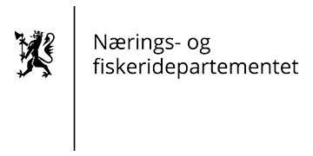
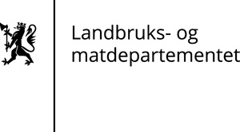


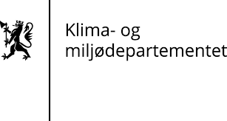


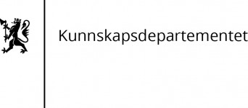


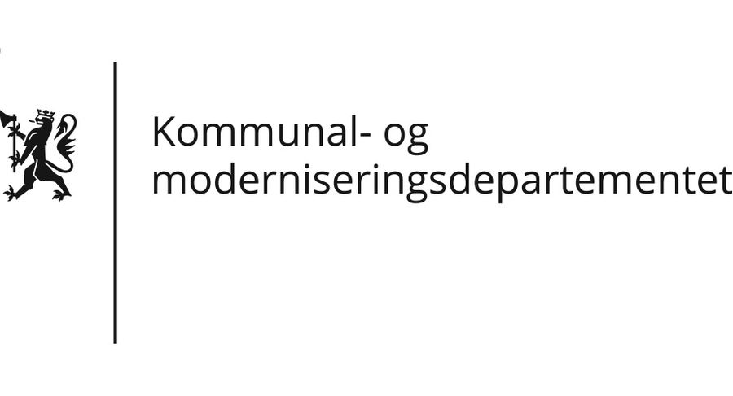
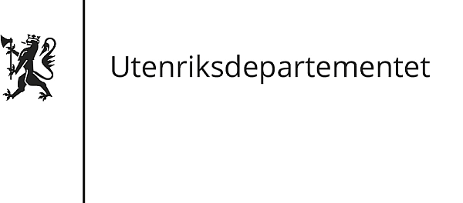



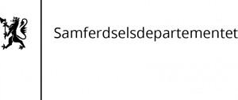
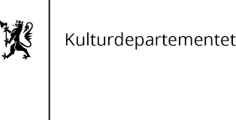


Delegating authorities

